Slide 1
Stochastic Pre-Classification for SDN Data Plane Matching
Author : Luke McHale, C. Jasson Casey, Paul V. Gratz, Alex Sprintson
Conference: 2014 IEEE 22nd International Conference on Network Protocols
Presenter: Tung-yin Chi
Date: 2015/7/22
Department of Computer Science and Information Engineering
National Cheng Kung University, Taiwan R.O.C.
Notes:
1
Ph.D. Student, Texas A&M University

Slide 2
Motivation
SDNs increase stress on Packet Classification
  Higher complexity compared to traditional networks
  Generalizing increases timing variability
Denial of Service (DoS) attacks on SDN switches are a potential issue
  Wastes resources, crowding out legitimate packets
  Inherent problem: traffic must be classified before it can be determined malicious

Slide 3
Packet Classification
Exact Matching
  Hash Tables
Prefix Match
  Tries
Arbitrary
  TCAM (limited in size/availability)

Slide 4
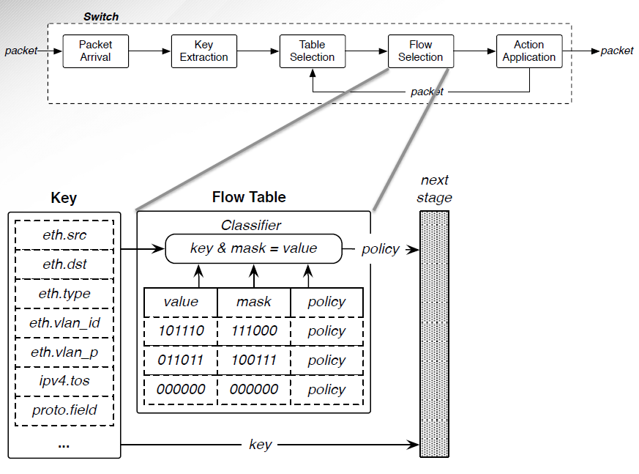
Packet Classification

Slide 5
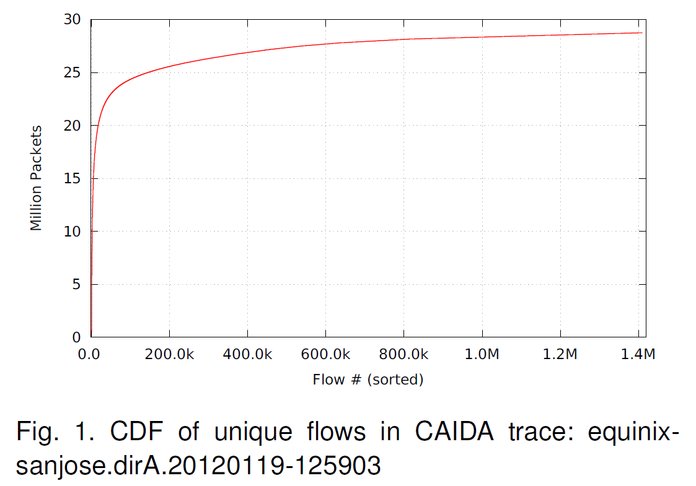
Flow Locality
35% of the flows contain 95% of the packets
  The active-flow window is constantly changing

Slide 6
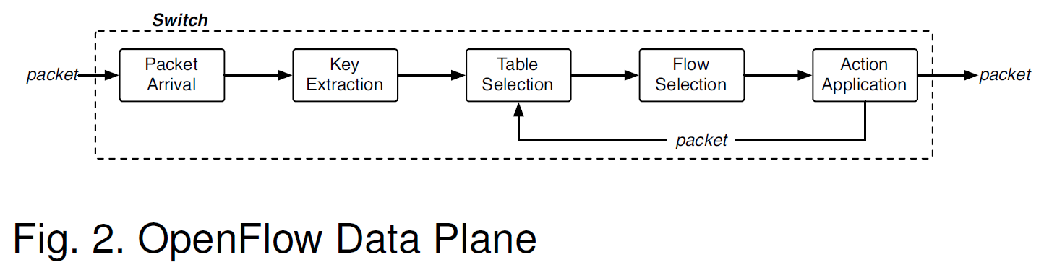
Flow Caching
Flow Locality -> Caching becomes fast-path
  Keeps high-throughput flows
  Lookup: exact-match using key (i.e. 5-tuple)
  Cache: action set
  Hits: bypass Table and Flow selection

Slide 7
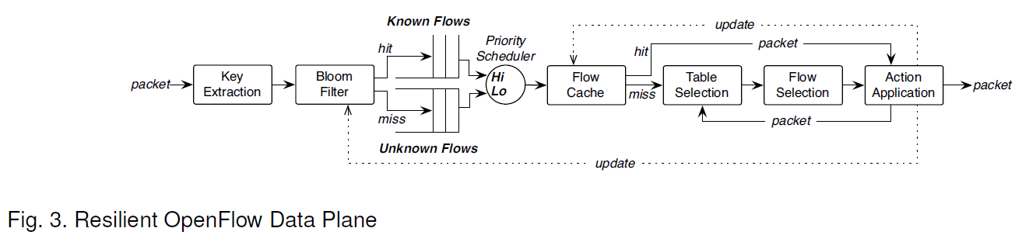
Pre-Classification
Attacks aim to stress slow-path (classification)
  When stressed, prioritize established traffic
  Lookup: exact-match using key (i.e. 5-tuple)
  Cache: seen before
  Hits: higher classification priority

Slide 8
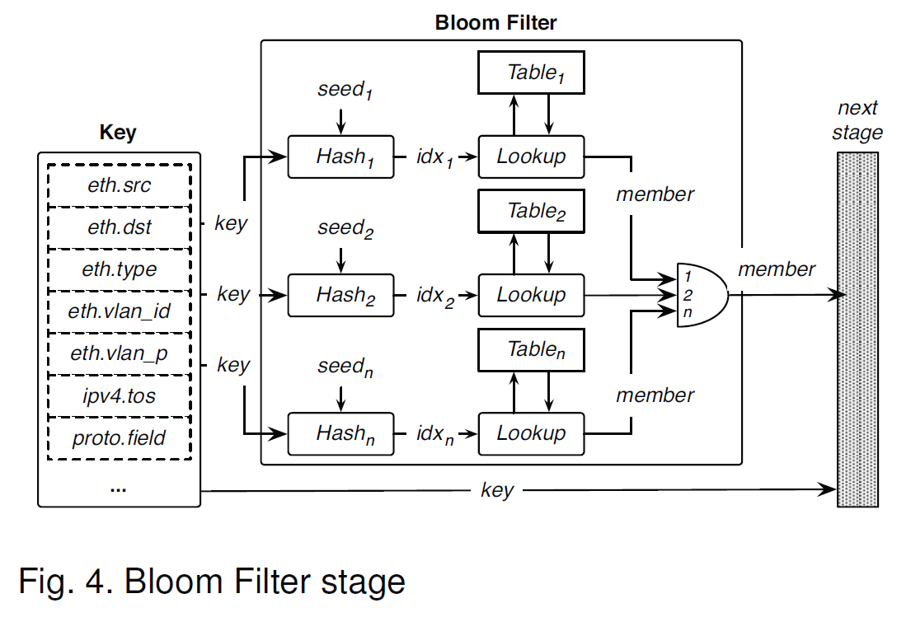
Bloom Filter
Hit: flow likely seen within epoch
Miss: flow definitely not seen within epoch
O[1] Lookups
O[1] Inserts

Slide 9
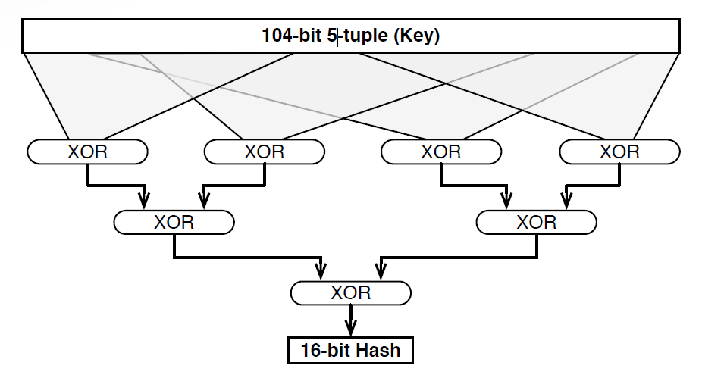
Bloom Filter: XOR Hash Function
Bit-level XOR helps preserve entropy
Avoid mixing heavily correlated bits

Slide 10
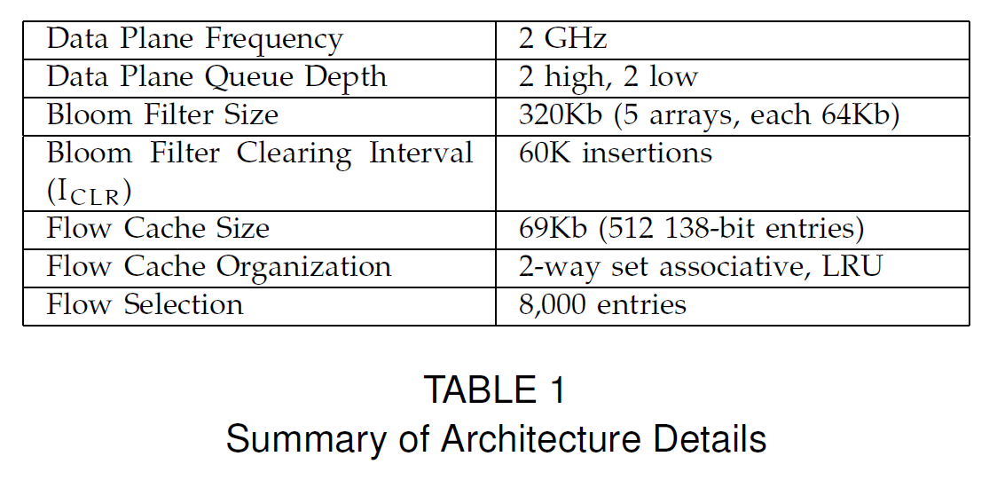
Experimental Setup

Slide 11
Firewall Application
Simulated Firewall Application
Access Control List (ACL)
  Protocol
  IP source/destination
  Port source/dest. ranges
Test ACL Generation
  95%: nominal network conditions
  60%: network with significant malicious traffic
  20%: network under attack

Slide 12
Results: Throughput
packet
Key Extraction
Table Selection
Flow Selection
Action Application
packet
packet
Baseline - 95%
Baseline - 60%
Baseline - 20%
1
❇ Stressed >1 Gbps
0.9
0.8
Normalized Throughput
0.7
0.6
0.5
0.4
0.3
0.2
0.1
0
1
10
40
Interface Speed (Gbps)
100

Slide 13
Results: Throughput
update
hit
packet
packet
Key Extraction
Flow Cache
Table Selection
Flow Selection
Action Application
packet
miss
packet
Baseline - 95%
Baseline - 60%
Baseline - 20%
Caching - 95%
Caching - 60%
Caching - 20%
1
❇ Stressed >1 Gbps
Throughput proportional to unauthorized traffic
0.9
0.8
Normalized Throughput
0.7
0.6
0.5
0.4
0.3
0.2
0.1
0
1
10
40
Interface Speed (Gbps)
100

Slide 14
Results: Throughput
Known Flows
hit
Priority
Scheduler
packet
Extraction
Filter
Lo
Selection
Selection
Application
packet
miss
packet
Unknown Flows
update
Baseline - 95%
Baseline - 60%
Baseline - 20%
Caching - 95%
Caching - 60%
Caching - 20%
Partition - 95%
Partition - 60%
Partition - 20%
1
❇ Stressed >1 Gbps
Throughput proportional to unauthorized traffic
▲ Unauthorized traffic has less impact on throughput
0.9
0.8
Normalized Throughput
0.7
0.6
0.5
0.4
0.3
0.2
0.1
0
1
10
40
Interface Speed (Gbps)
100

Slide 15
Results: Throughput
Known Flows
update
hit
Priority Scheduler
Hi Lo
hit
packet
packet
Key Extraction
Bloom Filter
Flow Cache
Table Selection
Flow Selection
Action Application
packet
miss
miss
packet
Unknown Flows
update
Baseline - 95%
Baseline - 60%
Baseline - 20%
Caching - 95%
Caching - 60%
Caching - 20%
Partition - 95%
Partition - 60%
Partition - 20%
Partition+Caching - 95%
Partition+Caching - 60%
Partition+Caching - 20%
1
❇ Stressed >1 Gbps
Throughput proportional to unauthorized traffic
▲ Unauthorized traffic has less impact on throughput
 More consistent throughput
0.9
0.8
Normalized Throughput
0.7
0.6
0.5
0.4
0.3
0.2
0.1
0
1
10
40
Interface Speed (Gbps)
100

Slide 16
Results: Latency
packet
Key Extraction
Table Selection
Flow Selection
Action Application
packet
packet
Baseline - 95%
Baseline - 60%
Baseline - 20%
9
❇ Queue saturation causes high latency >1 Gbps
8
7
Mean Latency (µs)
6
5
4
3
2
1
0
1
10
40
Interface Speed (Gbps)
100

Slide 17
Results: Latency
update
hit
packet
packet
Key Extraction
Flow Cache
Table Selection
Flow Selection
Action Application
packet
miss
packet
Baseline - 95%
Baseline - 60%
Baseline - 20%
Caching - 95%
Caching - 60%
Caching - 20%
9
❇ Queue saturation causes high latency >1 Gbps
Hits improve average latency
8
7
Mean Latency (µs)
6
5
4
3
2
1
0
1
10
40
Interface Speed (Gbps)
100

Slide 18
Results: Latency
Known Flows
hit
Priority
Scheduler
packet
Extraction
Filter
Lo
Selection
Selection
Application
packet
miss
packet
Unknown Flows
update
Baseline - 95%
Baseline - 60%
Baseline - 20%
Caching - 95%
Caching - 60%
Caching - 20%
Partition - 95%
Partition - 60%
Partition - 20%
9
❇ Queue saturation causes high latency >1 Gbps
Hits improve average latency
▲ Authorized traffic not yet seen incurs higher latency
▲ Once flow is learned, latency consistent with Baseline
8
7
Mean Latency (µs)
6
5
4
3
2
1
0
1
10
40
Interface Speed (Gbps)
100

Slide 19
Results: Latency
Known Flows
update
hit
Priority Scheduler
Hi Lo
hit
packet
packet
Key Extraction
Bloom Filter
Flow Cache
Table Selection
Flow Selection
Action Application
packet
miss
miss
packet
Unknown Flows
update
Baseline - 95%
Baseline - 60%
Baseline - 20%
Caching - 95%
Caching - 60%
Caching - 20%
Partition - 95%
Partition - 60%
Partition - 20%
Partition+Caching - 95%
Partition+Caching - 60%
Partition+Caching - 20%
9
❇ Queue saturation causes high latency >1 Gbps
Hits improve average latency
▲ Authorized traffic not yet seen incurs higher latency
▲ Once flow is learned, latency consistent with Cache
 Higher latency at start of flow
 Latency is constant with cache
8
7
Mean Latency (µs)
6
5
4
3
2
1
0
thereafter
1
10
40
Interface Speed (Gbps)
100

Slide 20
Results: Jitter
packet
Key Extraction
Table Selection
Flow Selection
Action Application
packet
packet
Baseline - 95%
Baseline - 60%
Baseline - 20%
9
❇ Peaks at saturation point
8
7
6
Jitter (µs)
5
4
3
2
1
0
1
10
40
Interface Speed (Gbps)
100

Slide 21
Results: Jitter
update
hit
packet
packet
Key Extraction
Flow Cache
Table Selection
Flow Selection
Action Application
packet
miss
packet
Baseline - 95%
Baseline - 60%
Baseline - 20%
Caching - 95%
Caching - 60%
Caching - 20%
9
❇ Peaks at saturation point
Difference in fast vs. slow path increases variance
8
7
6
Jitter (µs)
5
4
3
2
1
0
1
10
40
Interface Speed (Gbps)
100

Slide 22
Results: Jitter
Known Flows
hit
Priority
Scheduler
packet
Extraction
Filter
Lo
Selection
Selection
Application
packet
miss
packet
Unknown Flows
update
 |  | Baseline - 95% |  | Caching - 95% | Partition - 95%
 |  | Baseline - 60% |  | Caching - 60% | Partition - 60%
 | 35 | Baseline - 20% |  | Caching - 20% | Partition - 20%
❇ Peaks at saturation point
Difference in fast vs. slow path increases variance
▲ Learning path incurs higher latency -> jitter
▲ Once flow is learned, jitter consistent with Caching
30
25
Jitter (µs)
20
15
10
5
0
1
10
40
Interface Speed (Gbps)
100

Slide 23
Results: Jitter
Known Flows
update
hit
Priority Scheduler
Hi Lo
hit
packet
packet
Key Extraction
Bloom Filter
Flow Cache
Table Selection
Flow Selection
Action Application
packet
miss
miss
packet
Unknown Flows
update
 |  | Baseline - 95% |  | Caching - 95% | Partition - 95% | Partition+Caching - 95%
 |  | Baseline - 60% |  | Caching - 60% | Partition - 60% | Partition+Caching - 60%
 | 35 | Baseline - 20% |  | Caching - 20% | Partition - 20% | Partition+Caching - 20%
❇ Peaks at saturation point
Difference in fast vs. slow path increases variance
▲ Learning path incurs higher latency -> jitter
▲ Once flow is learned, jitter consistent with Caching
 Improves jitter incurred by
30
25
Jitter (µs)
20
15
10
5
0
1
10
40
Interface Speed (Gbps)
100
priority mechanism

Slide 24
Conclusions
Known Flows
update
hit
Priority Scheduler
Hi Lo
hit
packet
packet
Key Extraction
Bloom Filter
Flow Cache
Table Selection
Flow Selection
Action Application
packet
miss
miss
packet
Unknown Flows
update
SDN complexity increases stress on Classification
Flow Cache minimizes the effect of repeatedly classifying high-throughput flows
  Increases effective throughput
Pre-Classification prioritizes known traffic
  Reduces effect of malicious traffic
Combined architecture provides orthogonal benefit
  Helps decouple legitimate and malicious traffic

Slide 25
Results: Throughput
Known Flows
update
hit
Priority Scheduler
Hi Lo
hit
packet
packet
Key Extraction
Bloom Filter
Flow Cache
miss
Table Selection
Flow Selection
Action Application
packet
miss
packet
Unknown Flows
update
Baseline - 95%
Baseline - 60%
Baseline - 20%
Caching - 95%
Caching - 60%
Caching - 20%
Partition - 95%
Partition - 60%
Partition - 20%
Partition+Caching - 95%
Partition+Caching - 60%
Partition+Caching - 20%
1
0.9
0.8
Normalized Throughput
0.7
0.6
0.5
0.4
0.3
0.2
0.1
0
1
10
40
Interface Speed (Gbps)
100
25

Slide 26
Results: Latency
Known Flows
update
hit
Priority Scheduler
Hi Lo
hit
packet
packet
Key Extraction
Bloom Filter
Flow Cache
miss
Table Selection
Flow Selection
Action Application
packet
miss
packet
Unknown Flows
update
Baseline - 95%
Baseline - 60%
Baseline - 20%
Caching - 95%
Caching - 60%
Caching - 20%
Partition - 95%
Partition - 60%
Partition - 20%
Partition+Caching - 95%
Partition+Caching - 60%
Partition+Caching - 20%
9
8
7
Mean Latency (µs)
6
5
4
3
2
1
0
1
10
40
100
26
Interface Speed (Gbps)

Slide 27
Results: Jitter
Known Flows
update
hit
Priority Scheduler
Hi Lo
hit
packet
packet
Key Extraction
Bloom Filter
Flow Cache
miss
Table Selection
Flow Selection
Action Application
packet
miss
packet
Unknown Flows
update
Baseline - 95%
Baseline - 60%
Baseline - 20%
Caching - 95%
Caching - 60%
Caching - 20%
Partition - 95%
Partition - 60%
Partition - 20%
Partition+Caching - 95%
Partition+Caching - 60%
Partition+Caching - 20%
35
30
25
Jitter (µs)
20
15
10
5
0
1
10
40
100
27
Interface Speed (Gbps)

